Slide 1







Quercus Quickstart - Before we get started
Quercus Quickstart
Before we get started
During the webinar
Following the webinar
      Let us know if you can hear us when we do Audio checks
  Your microphone
  will be muted until Q&A at the end of the session
  View Session Recording
  at uoft.me/ctsi-videos
  in about 2 business days
  Turn on live captions if you would like closed captioning
  Type questions and comments into the Chat
  Complete Feedback Survey (link sent via email)
  Download Presentation Slides at uoft.me/ctsi-videos

Slide 2
Agenda:
10am-11am, Overview of Quercus for instructors
11:00-11:10, Break
11:10-11:30, Importing a course template, creating a homepage
11:30-noon, Questions and sharing of instructor use cases

Slide 3
Overview of Quercus for instructors
- Accessing Quercus & Your Courses - Overview & Navigation - Course Customization - Announcements & Communication - Adding Course Content - Assignments & Grading - Quercus Logistics & Course Lifecycle

Slide 4



What is Quercus?
teaching.utoronto.ca/educational-technology/

Slide 5
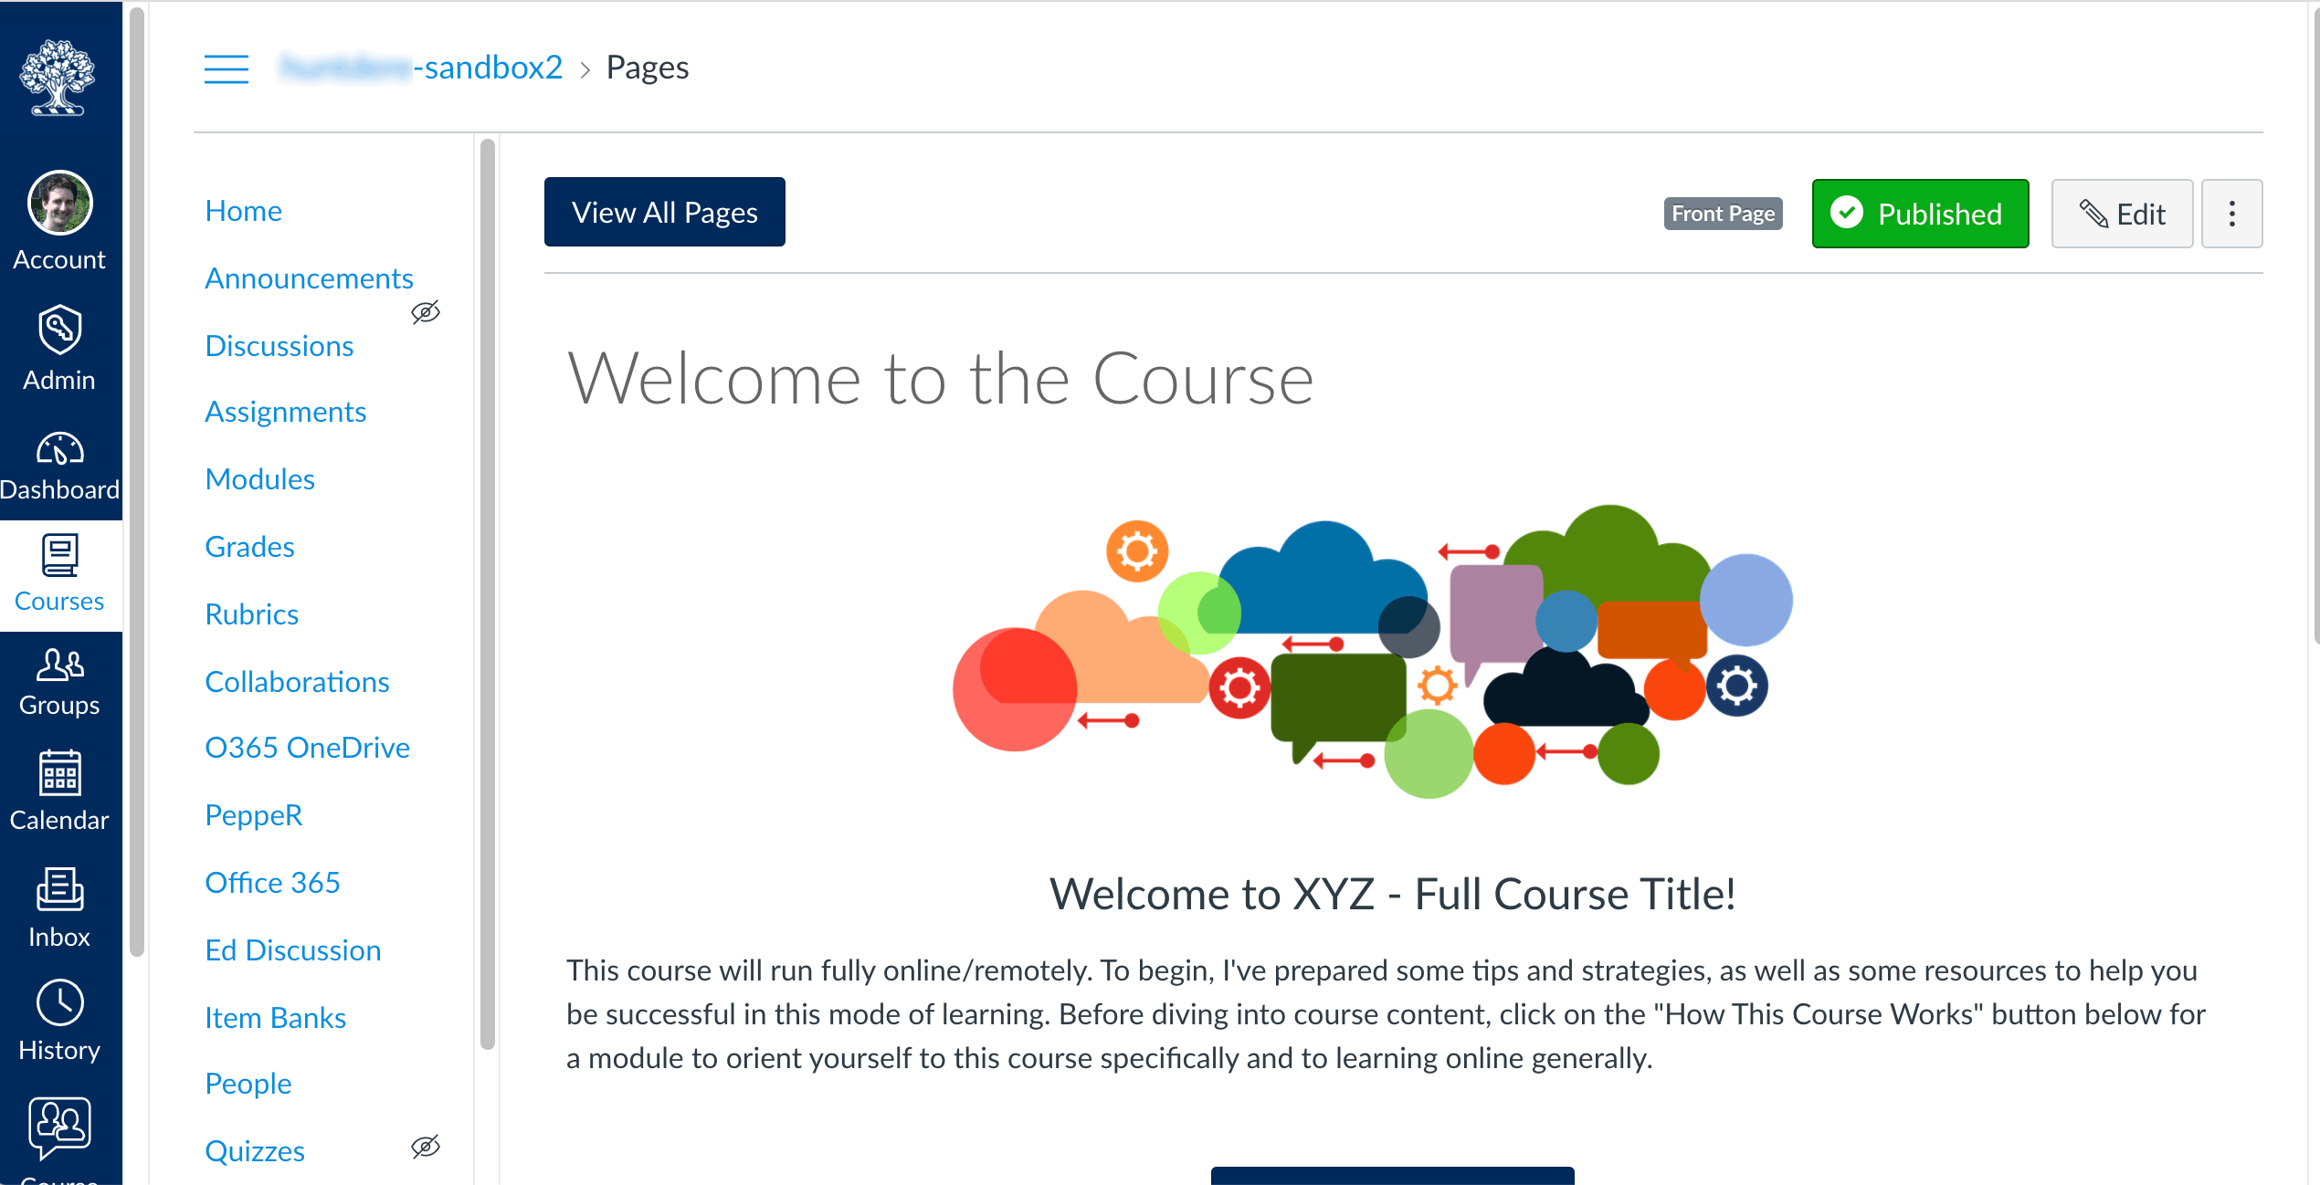
Let’s take a tour of a Quercus course

Slide 6
Break time!

Slide 7
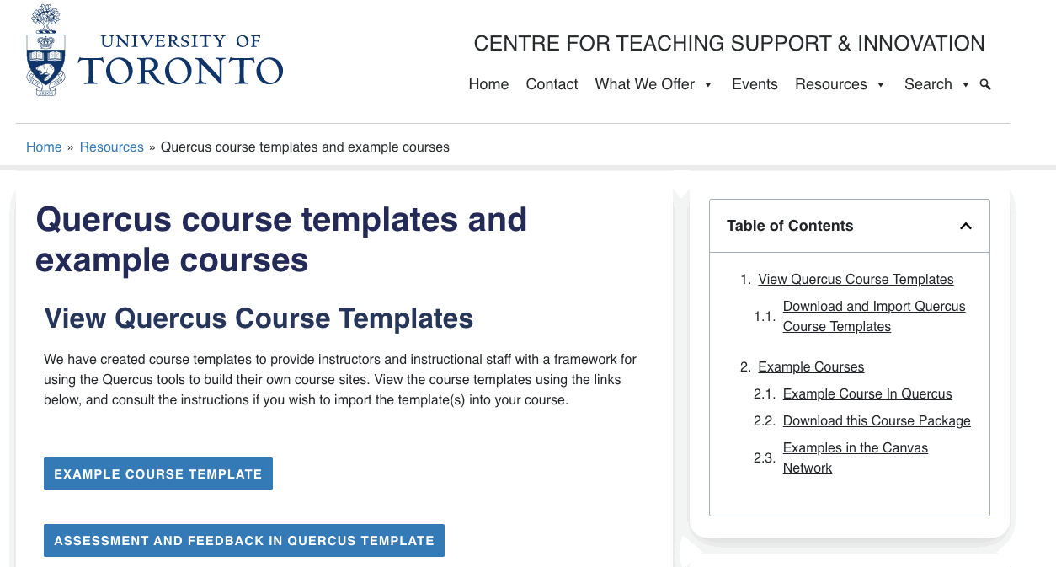
Import a course template
https://teaching.utoronto.ca/resources/quercus-course-templates-and-example-courses/

Slide 8
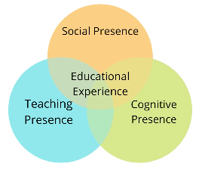
Building a Welcoming Home Page in Quercus
New Asynchronous Program:
Building a Welcoming Home Page in Quercus
Social Presence
  The Home Page lets students know that they are part of a community of learners.
  The Home Page provides access to an online location for discussions/ questions.
Teaching Presence
  The Home Page introduces students to the teaching team.
  The Home provides information about how the course functions.
Cognitive Presence
  The Home Page draws attention to key course learning goals/outcomes.
  The Home Page includes a visual that represents the subject matter.
Accessibility
  Accessibility The Home Page passed the Accessibility Checker.
  Materials on the Home Page (e.g., videos, linked content) are accessible.
Register at: uoft.me/q-homepage

Slide 9
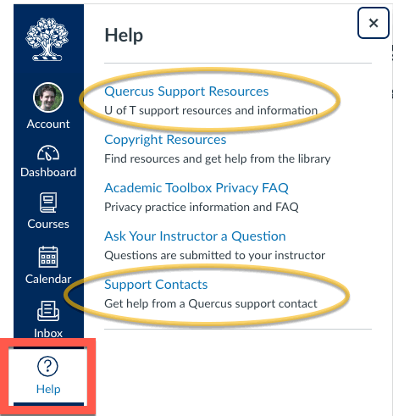
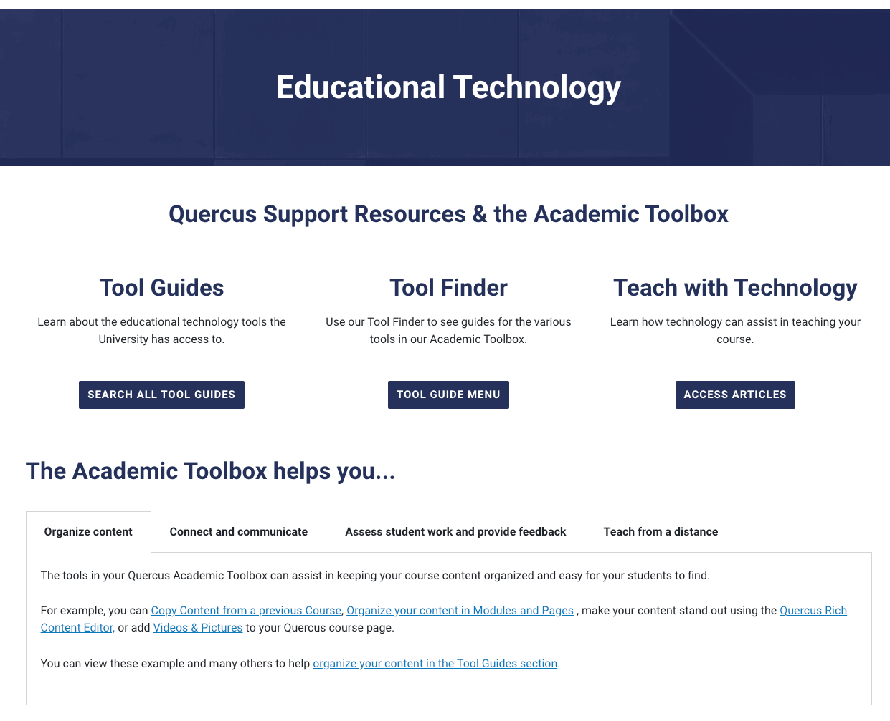
Quercus support resources
UofT.me/qresources

Slide 10
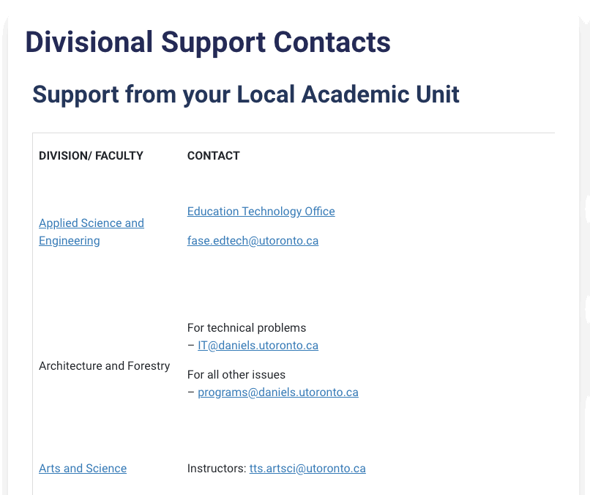
Where to get assistance - Divisional support
uoft.me/qsupportcontacts

Slide 11
Webinar Recordings and Events
Online/remote teaching webinars
Recordings and materials: uoft.me/ctsi-videos Upcoming CTSI events: teaching.utoronto.ca/events

Slide 12
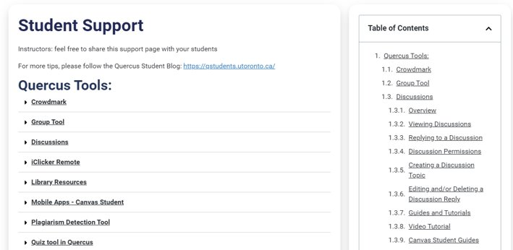
Student support resources
UofT.me/q-student

Slide 13
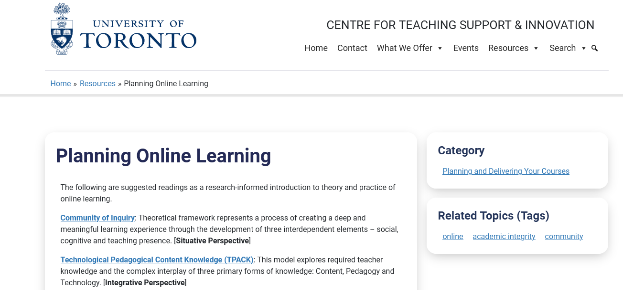
Planning guide: Online Learning
teaching.utoronto.ca/resources/planning-online-learning/

Slide 14

Once your Quercus course is done – have a Quercus course review
teaching.utoronto.ca/teaching-feedback-services/quercus-course-reviews/

Slide 15
Questions?
Thank you!
CTSI website: teaching.utoronto.ca
Upcoming events: teaching.utoronto.ca/events
Quercus Support Resources: uoft.me/qresources
Divisional Support: uoft.me/qsupportcontacts
CTSI webinar recordings: uoft.me/ctsi-videos
Questions: q.help@utoronto.ca

